Slide 1
Project Proposal
P76044025 黃粲富
P76044059 張傑程
P76044481 吳邦宇

Slide 2
Outline
Basic idea
System flow
Environment
Techniques
Division of work

Slide 3
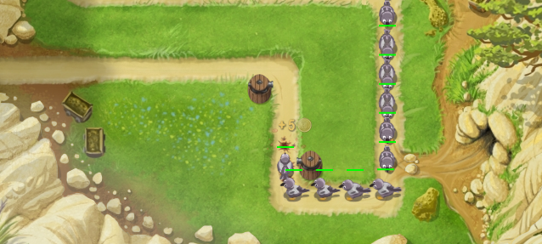
Basic idea

Slide 4
Basic idea
A tower defense game
Towers are represented by real-world tags
Players could move towers by moving the real-world tags

Slide 5
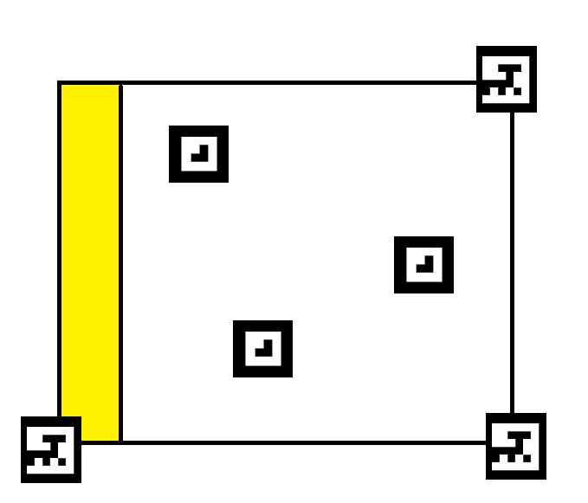
Basic idea
角上 : 定位tag
白色區域內 : tower tag
黃色特殊區塊 : 將tower tag移入可進行升級等動作
實際上會不只一個特殊區塊，某些區塊拿來升級，某些區塊拿來合成等等

Slide 6
Basic idea
怪物會從多條路線進入場內，每個路線的怪物屬性不同
每種防禦塔的屬性也不同，屬性相剋
每條路線的怪物屬性都會隨時間調整
玩家須隨時移動防禦塔到適合的位置

Slide 7
Outline
Basic idea
System flow
Environment
Techniques
Division of work

Slide 8
System flow
透過定位tag確定是否準備完畢
準備完畢後可以選擇難度並開始遊戲
玩家根據場上怪物情況來建造、移動防禦塔位置與方向等等
遊戲詳細流程與機制仍須設計(EX : 升級或合成等動作如何完成)
玩家將主堡定位
選擇難度(路線)
怪物進攻
移動或建設、升級防禦塔

Slide 9
Outline
Basic idea
System flow
Environment
Techniques
Division of work

Slide 10
Environment
Mainly on PC with a camera
Mobile version if we’ve enough time

Slide 11
Outline
Basic idea
System flow
Environment
Techniques
Division of work

Slide 12
Techniques
AR game design
Game programming
Real-time tag recognition / tracking

Slide 13
Outline
Basic idea
System flow
Environment
Techniques
Division of work

Slide 14
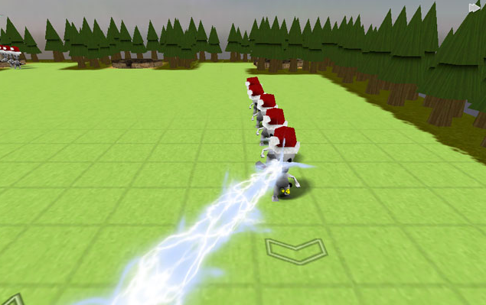
Division of work
Game design, Game programming, Tag design
Game design, Game programming, Camera
Game design, Game programming, Integrate
3D Models if we’ve enough time

